Slide 1
Network Applications: Network Programming: UDP, TCP
Qiao Xiang
https://qiaoxiang.me/courses/cnns-xmuf21/index.shtml
10/12/2021
This deck of slides are heavily based on CPSC 433/533 at Yale University, by courtesy of Dr. Y. Richard Yang.

Slide 2
Outline
Admin. and recap
Network application programming
UDP sockets
TCP sockets
Network applications (continue)
File transfer (FTP) and extension

Slide 3
Recap: Connectionless UDP: Big Picture (Java version)
Server (running on serv)
Client
create socket,
port=x, for
incoming request:
create socket,
clientSocket =
DatagramSocket()
serverSocket =
DatagramSocket( x )
Create datagram using (serv, x) as (dest addr. port), send request using clientSocket
read request from
serverSocket
generate reply, create datagram using client
host address, port number
write reply to
serverSocket
read reply from
clientSocket
close
clientSocket

Slide 4
Recap: UDP Sockets
server
Public address: 128.36.59.2 Local address: 127.0.0.1
UDP socket space
InetAddress sIP1 =
InetAddress.getByName(“localhost”);
DatagramSocket ssock1 = new DatagramSocket(9876, sIP1);
InetAddress sIP2 = InetAddress.getByName(“128.36.59.2”);
DatagramSocket ssock2 = new DatagramSocket(9876,sIP2);
DatagramSocket serverSocket = new DatagramSocket(6789);
address: {127.0.0.1:9876}
snd/recv buf:
address: {128.36.59.2:9876}
snd/recv buf:
address: {*:6789}
snd/recv buf:
address: {128.36.232.5:53}
snd/recv buf:
UDP demutiplexing is based on matching (dst address, dst port)

Slide 5
Java Server (UDP): Processing
A simple upper-case UDP echo service is among the simplest network service. Are there any problems with the processing?
class UDPServer {
public static void main(String args[]) throws Exception {
… DatagramPacket receivePacket = new DatagramPacket(receiveData, receiveData.length);
serverSocket.receive(receivePacket);
// process
String sentence = new String(receivePacket.getData(), 0, receivePacket.getLength());
String capitalizedSentence = sentence.toUpperCase();
sendData = capitalizedSentence.getBytes();
// send DatagramPacket sendPacket = new DatagramPacket(sendData, sendData.length, IPAddress, port);
serverSocket.send(sendPacket);

Slide 6
Example: Java client (UDP)
import java.io.*;
import java.net.*;
class UDPClient {
public static void main(String args[]) throws Exception
{
BufferedReader inFromUser =
new BufferedReader(new InputStreamReader(System.in));
String sentence = inFromUser.readLine(); byte[] sendData = sentence.getBytes();
DatagramSocket clientSocket = new DatagramSocket();
InetAddress sIPAddress = InetAddress.getByName(“servname");
Create
input stream
Create
client socket
Translate
hostname to IP
address using DNS

Slide 7
Example: Java client (UDP), cont.
Create datagram with data-to-send,
length, IP addr, port
DatagramPacket sendPacket =
new DatagramPacket(sendData, sendData.length, sIPAddress, 9876);
clientSocket.send(sendPacket);
byte[] receiveData = new byte[1024];
DatagramPacket receivePacket =
new DatagramPacket(receiveData, receiveData.length);
clientSocket.receive(receivePacket);
String modifiedSentence =
new String(receivePacket.getData());
System.out.println("FROM SERVER:" + modifiedSentence);
clientSocket.close();
}
}
Send datagram
to server
Read datagram
from server

Slide 8
Demo
%ubuntu: java UDPServer
%netstat to see buffer
%ubuntu: java UDPClient <server>
%wireshark to capture traffic
Notes:
System.out.println(clientSocket.getLocalAddress());
System.out.println(clientSocket.getLocalPort());
System.out.println(clientSocket.getReceiveBufferSize());
System.out.println(clientSocket.getSendBufferSize());
System.out.println(clientSocket.getSoTimeout());
System.out.println( java.nio.charset.Charset.defaultCharset() );

Slide 9
Discussion on Example Code
A simple upper-case UDP echo service is among the simplest network service.
Are there any problems with the program?
Notes:
System.out.println(clientSocket.getLocalAddress());
System.out.println(clientSocket.getLocalPort());
System.out.println(clientSocket.getReceiveBufferSize());
System.out.println(clientSocket.getSendBufferSize());
System.out.println(clientSocket.getSoTimeout());
System.out.println( java.nio.charset.Charset.defaultCharset() );

Slide 10
Data Encoding/Decoding
Rule: ALWAYS pay attention to encoding/decoding of data
if not careful, query sent != query received (how?)
client
server
query
result
encoding
decoding
byte
array

Slide 11
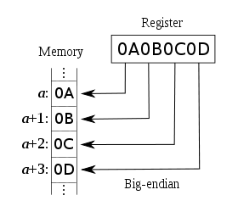
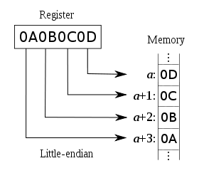
Example: Endianness of Numbers
int var = 0x0A0B0C0D
sent != received: take an int on a big-endian machine and send a little-endian machine
ARM, Power PC, Motorola 68k, IA-64
Intel x86

Slide 12
Example: String and Chars
Will we always get back the same string?
client
server
String
String
(UTF-16)
(UTF-16)
String.getBytes()
String(rcvPkt, 0, rcvPkt.getLength());
byte
array
Depends on default local platform char set : java.nio.charset.Charset.defaultCharset()

Slide 13
Example: Charset Troubles
Try
java EncodingDecoding US-ASCII UTF-8
Notes:
System.out.println(clientSocket.getLocalAddress());
System.out.println(clientSocket.getLocalPort());
System.out.println(clientSocket.getReceiveBufferSize());
System.out.println(clientSocket.getSendBufferSize());
System.out.println(clientSocket.getSoTimeout());
System.out.println( java.nio.charset.Charset.defaultCharset() );

Slide 14
Encoding/Decoding as a Common Source of Errors
Please read chapter 2 (Streams) of Java Network Programming for more details
Java stream, reader/writer can always be confusing, but it is good to finally understand
Common mistake even in many (textbook) examples:
http://www.java2s.com/Code/Java/Network-Protocol/UseDatagramSockettosendoutandreceiveDatagramPacket.htm
Notes:
System.out.println(clientSocket.getLocalAddress());
System.out.println(clientSocket.getLocalPort());
System.out.println(clientSocket.getReceiveBufferSize());
System.out.println(clientSocket.getSendBufferSize());
System.out.println(clientSocket.getSoTimeout());
System.out.println( java.nio.charset.Charset.defaultCharset() );

Slide 15
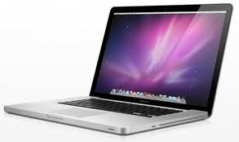
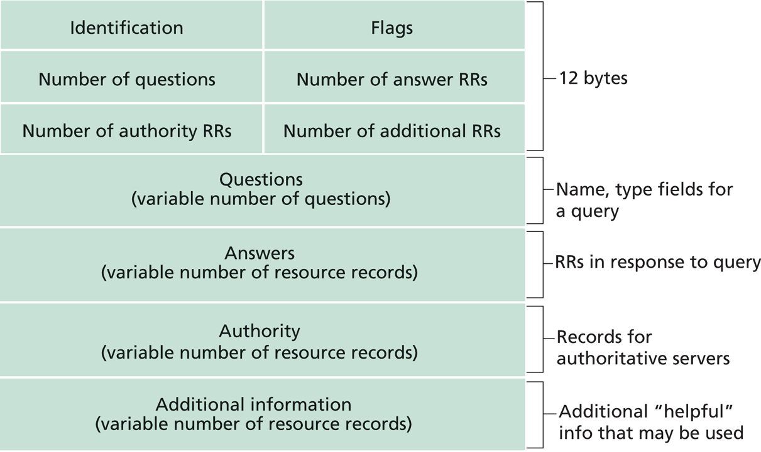
Exercise: UDP/DNS Server Pseudocode
Modify the example UDP server code to implement a local DNS server.
root name server
2
3
4
7
local name server
130.132.1.9
TLD name server
6
5
1
8
authoritative name server
dns.cs.umass.edu
requesting host
cyndra.cs.yale.edu
gaia.cs.umass.edu

Slide 16
UDP/DNS Implementation
Standard UDP demultiplexing (find out return address by src.addr/src.port of UDP packet) does not always work
DNS solution: identification: remember the mapping

Slide 17
Outline
Admin. and recap
Network application programming
Overview
UDP
Basic TCP

Slide 18
TCP Socket Design: Starting w/ UDP
server
client1
128.36.232.5 128.36.230.2
P1
Socket socket space
address: {*:9876}
snd/recv buf:
client2
P2
local port
Issue: If a single socket, data can be mixed, but TCP is designed to provide a pipe abstraction: server reads an ordered sequence of bytes from each individual client.
local address
sock.nextByte(client1)?
Issue 2: How to notify an app that a new client is connected?
newClient = sock.getNewClient()?

Slide 19
BSD TCP Socket API Design
server
socket for new connected clients
128.36.232.5 128.36.230.2
TCP socket space
address: {*:9876}
snd/recv buf:
client1
An individual socket for client 1
P1
address: {*:9876; client 1 IP/port}
snd/recv buf:
client2
An individual socket for client 2
address: {*:9876; client 2 IP/port}
snd/recv buf:
P2
Q: How to decide where to put a new TCP packet?
A: Packet demutiplexing is based on four tuples: (dst addr, dst port, src addr, src port)

Slide 20
TCP Connection-Oriented Demux
TCP socket identified by 4-tuple:
source IP address
source port number
dest IP address
dest port number
recv host uses all four values to direct segment to appropriate socket
different connections/sessions are automatically separated into different sockets

Slide 21
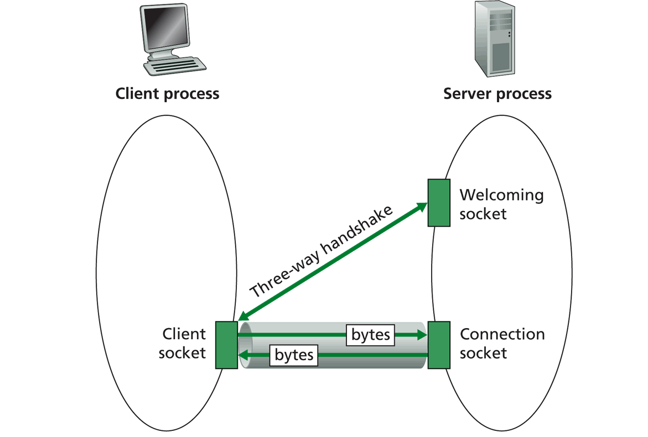
TCP Socket Big Picture
Welcome socket: the waiting room
connSocket: the operation room

Slide 22
Client/server Socket Workflow: TCP
Server (running on hostid)
Client
create socket,
port=x, for
incoming request:
welcomeSocket =
ServerSocket(x)
TCP
connection setup
create socket,
connect to hostid, port=x
wait for incoming
connection request
connectionSocket =
welcomeSocket.accept()
clientSocket =
Socket()
send request using
clientSocket
read request from
connectionSocket
write reply to
connectionSocket
read reply from
clientSocket
close
connectionSocket
close
clientSocket

Slide 23
Server Flow
Create ServerSocket(6789)
connSocket = accept()
read request from connSocket
Welcome socket: the waiting room
connSocket: the operation room
Serve the request
close connSocket

Slide 24
ServerSocket
ServerSocket()
creates an unbound server socket.
ServerSocket(int port)
creates a server socket, bound to the specified port.
ServerSocket(int port, int backlog)
creates a server socket and binds it to the specified local port number, with the specified backlog.
ServerSocket(int port, int backlog, InetAddress bindAddr)
creates a server with the specified port, listen backlog, and local IP address to bind to.
bind(SocketAddress endpoint)
binds the ServerSocket to a specific address (IP address and port number).
bind(SocketAddress endpoint, int backlog)
binds the ServerSocket to a specific address (IP address and port number).
Socket accept()
listens for a connection to be made to this socket and accepts it.
close()
closes this socket.

Slide 25
(Client)Socket
Socket(InetAddress address, int port)
creates a stream socket and connects it to the specified port number at the specified IP address.
Socket(InetAddress address, int port, InetAddress localAddr, int localPort)
creates a socket and connects it to the specified remote address on the specified remote port.
Socket(String host, int port)
creates a stream socket and connects it to the specified port number on the named host.
bind(SocketAddress bindpoint)
binds the socket to a local address.
connect(SocketAddress endpoint)
connects this socket to the server.
connect(SocketAddress endpoint, int timeout)
connects this socket to the server with a specified timeout value.
InputStream getInputStream()
returns an input stream for this socket.
OutputStream getOutputStream()
returns an output stream for this socket.
close()
closes this socket.

Slide 26
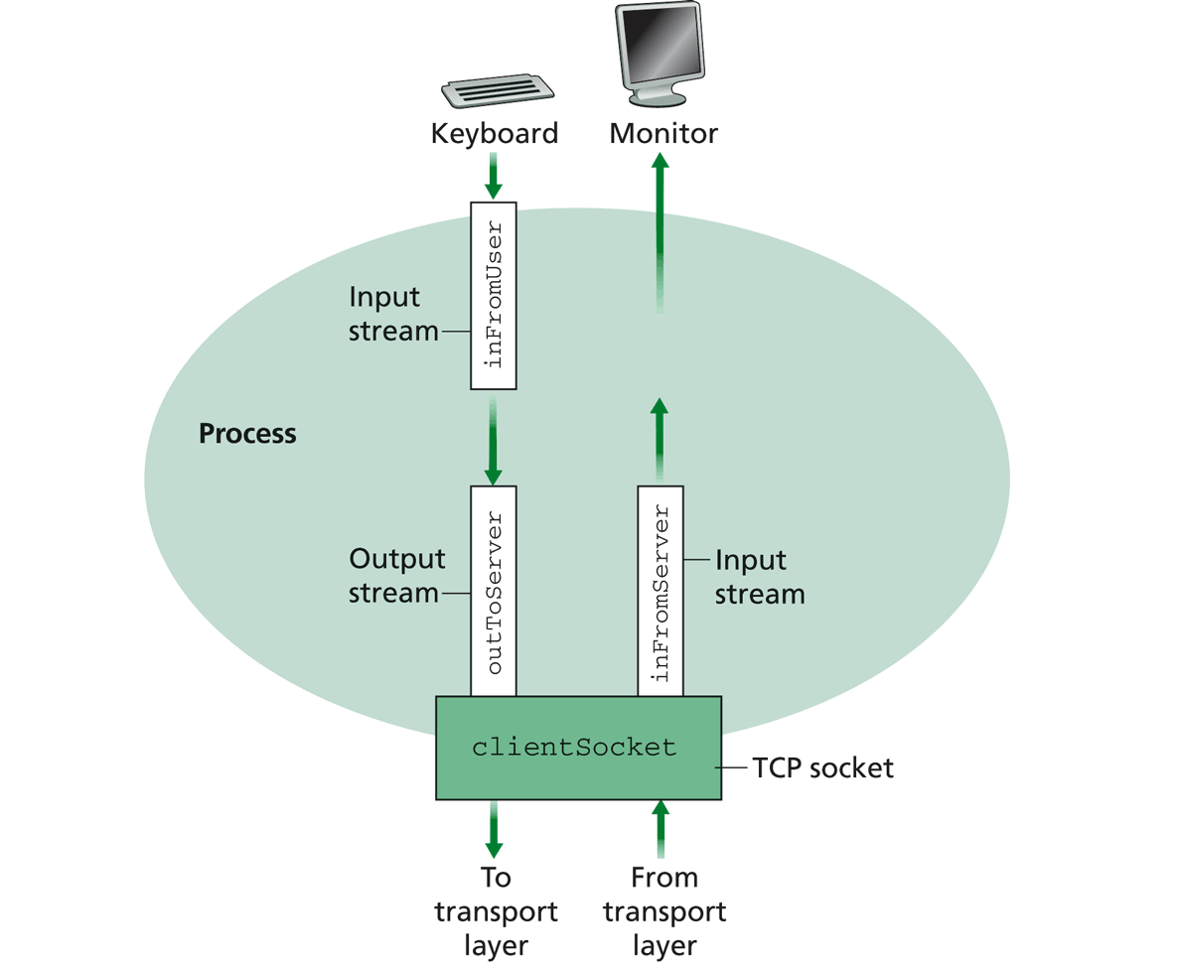
Simple TCP Example
Example client-server app:
1) client reads line from standard input (inFromUser stream) , sends to server via socket (outToServer stream)
2) server reads line from socket
3) server converts line to uppercase, sends back to client
4) client reads, prints modified line from socket (inFromServer stream)

Slide 27
Example: Java client (TCP)
import java.io.*;
import java.net.*;
class TCPClient {
public static void main(String argv[]) throws Exception
{
String sentence;
String modifiedSentence;
BufferedReader inFromUser =
new BufferedReader(new InputStreamReader(System.in));
sentence = inFromUser.readLine();
Socket clientSocket = new Socket(“server.name", 6789);
DataOutputStream outToServer =
new DataOutputStream(clientSocket.getOutputStream());
Create
input stream
Create
client socket,
connect to server
Create
output stream
attached to socket

Slide 28
OutputStream
public abstract class OutputStream
public abstract void write(int b) throws IOException
public void write(byte[] data) throws IOException
public void write(byte[] data, int offset, int length) throws IOException
public void flush( ) throws IOException
public void close( ) throws IOException

Slide 29
InputStream
public abstract class InputStream
public abstract int read( ) throws IOException
public int read(byte[] input) throws IOException
public int read(byte[] input, int offset, int length) throws IOException
public long skip(long n) throws IOException
public int available( ) throws IOException
public void close( ) throws IOException

Slide 30
Example: Java client (TCP), cont.
Send line
to server
outToServer.writeBytes(sentence + '\n');
BufferedReader inFromServer =
new BufferedReader(new
InputStreamReader(clientSocket.getInputStream()));
modifiedSentence = inFromServer.readLine();
System.out.println("FROM SERVER: " + modifiedSentence);
clientSocket.close();
}
}
Create
input stream
attached to socket
Read line
from server

Slide 31
Example: Java server (TCP)
import java.io.*;
import java.net.*;
class TCPServer {
public static void main(String argv[]) throws Exception
{
String clientSentence;
String capitalizedSentence;
ServerSocket welcomeSocket = new ServerSocket(6789);
while(true) {
Socket connectionSocket = welcomeSocket.accept();
BufferedReader inFromClient =
new BufferedReader(new
InputStreamReader(connectionSocket.getInputStream()));
Create
welcoming socket
at port 6789

Slide 32
Demo
% on MAC
start TCPServer
wireshark to capture our TCP traffic tcp.srcport==6789 or tcp.dstport==6789

Slide 33
Under the Hood: After Welcome (Server) Socket
server
client
128.36.232.5 128.36.230.2
198.69.10.10
TCP socket space
TCP socket space
state: listening
address: {*:6789, *:*}
completed connection queue:
sendbuf:
recvbuf:
state: starting
address: {198.69.10.10:1500, *:*}
sendbuf:
recvbuf:
local port
local addr
remote port
remote addr
state: listening
address: {*:25, *:*}
completed connection queue:
sendbuf:
recvbuf:
state: listening
address: {*:25, *:*}
completed connection queue:
sendbuf:
recvbuf:
%netstat –p tcp –n -a

Slide 34
After Client Initiates Connection
server
client
128.36.232.5 128.36.230.2
198.69.10.10
TCP socket space
TCP socket space
state: listening
address: {*:6789, *.*}
completed connection queue:
sendbuf:
recvbuf:
state: connecting
address: {198.69.10.10:1500, 128.36.232.5:6789}
sendbuf:
recvbuf:
state: listening
address: {*.25, *.*}
completed connection queue:
sendbuf:
recvbuf:
state: listening
address: {*.25, *.*}
completed connection queue:
sendbuf:
recvbuf:
%ubuntu java TCPClient <server> 6789

Slide 35
Example: Client Connection Handshake Done
server
client
128.36.232.5 128.36.230.2
198.69.10.10
TCP socket space
TCP socket space
state: listening
address: {*:6789, *:*}
completed connection queue: {128.36.232.5.6789, 198.69.10.10.1500}
sendbuf:
recvbuf:
state: connected
address: {198.69.10.10:1500, 128.36.232.5:6789}
sendbuf:
recvbuf:
state: listening
address: {*:25, *:*}
completed connection queue:
sendbuf:
recvbuf:
state: listening
address: {*:25, *:*}
completed connection queue:
sendbuf:
recvbuf:

Slide 36
Example: Client Connection Handshake Done
server
client
128.36.232.5 128.36.230.2
198.69.10.10
TCP socket space
TCP socket space
state: listening
address: {*.6789, *:*}
completed connection queue: sendbuf:
recvbuf:
state: connected
address: {198.69.10.10.1500, 128.36.232.5:6789}
sendbuf:
recvbuf:
state: established
address: {128.36.232.5:6789, 198.69.10.10.1500}
sendbuf:
recvbuf:
state: listening
address: {*.25, *:*}
completed connection queue:
sendbuf:
recvbuf:
state: listening
address: {*.25, *:*}
completed connection queue:
sendbuf:
recvbuf:
Packet demutiplexing is based on (dst addr, dst port, src addr, src port)
Packet sent to the socket with the best match!

Slide 37
Demo
What if more client connections than backlog allowed?
We continue to start java TCPClient

Slide 38
Example: Java server (TCP)
import java.io.*;
import java.net.*;
class TCPServer {
public static void main(String argv[]) throws Exception
{
String clientSentence;
String capitalizedSentence;
ServerSocket welcomeSocket = new ServerSocket(6789);
while(true) {
Socket connectionSocket = welcomeSocket.accept();
BufferedReader inFromClient =
new BufferedReader(new
InputStreamReader(connectionSocket.getInputStream()));
Wait, on welcoming
socket for contact
by client

Slide 39
Example: Server accept()
server
client
connectionSocket
128.36.232.5 128.36.230.2
198.69.10.10
TCP socket space
TCP socket space
state: listening
address: {*.6789, *:*}
completed connection queue: sendbuf:
recvbuf:
state: connected
address: {198.69.10.10.1500, 128.36.232.5:6789}
sendbuf:
recvbuf:
state: established
address: {128.36.232.5:6789, 198.69.10.10.1500}
sendbuf:
recvbuf:
state: listening
address: {*.25, *:*}
completed connection queue:
sendbuf:
recvbuf:
state: listening
address: {*.25, *:*}
completed connection queue:
sendbuf:
recvbuf:

Slide 40
Example: Java server (TCP): Processing
BufferedReader inFromClient =
new BufferedReader(new
InputStreamReader(connectionSocket.getInputStream()));
clientSentence = inFromClient.readLine();
capitalizedSentence = clientSentence.toUpperCase() + '\n'; DataOutputStream outToClient =
new DataOutputStream(connectionSocket.getOutputStream());
outToClient.writeBytes(capitalizedSentence);
}
}
}
Create input
stream, attached
to socket
Read in line
from socket

Slide 41
Example: Java server (TCP): Output
BufferedReader inFromClient =
new BufferedReader(new
InputStreamReader(connectionSocket.getInputStream()));
clientSentence = inFromClient.readLine();
capitalizedSentence = clientSentence.toUpperCase() + '\n'; DataOutputStream outToClient =
new DataOutputStream(connectionSocket.getOutputStream());
outToClient.writeBytes(capitalizedSentence);
}
}
}
Create output
stream, attached
to socket
Write out line
to socket
End of while loop,
loop back and wait for
another client connection

Slide 42
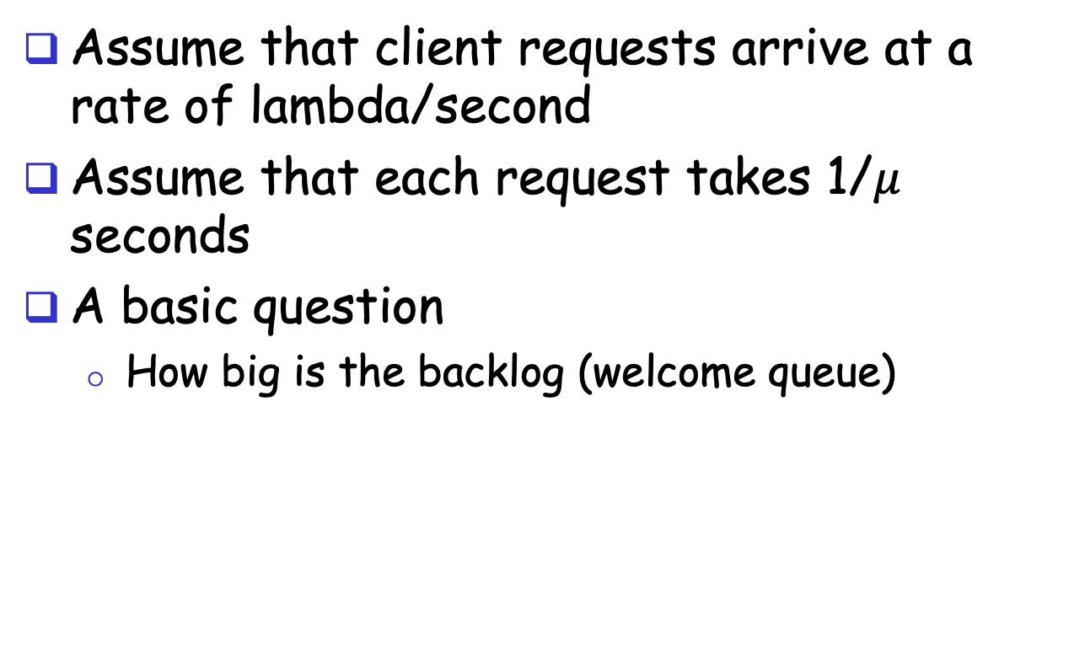
Analysis
Assume that client requests arrive at a rate of lambda/second
Assume that each request takes 1/$μ$ seconds
A basic question
How big is the backlog (welcome queue)
Welcome Socket Queue

Slide 43
Analysis
Is there any interop issue in the sample program?

Slide 44
Analysis
Is there any interop issue in the sample program?
DataOutputStream writeBytes(String) truncates
http://docs.oracle.com/javase/1.4.2/docs/api/java/io/DataOutputStream.html#writeBytes(java.lang.String)

Slide 45
Summary: Basic Socket Programming
They are relatively straightforward
UDP: DatagramSocket
TCP: ServerSocket, Socket
The main function of socket is multiplexing/demultiplexing to application processes
UDP uses (dst IP, port)
TCP uses (src IP, src port, dst IP, dst port)
Always pay attention to encoding/decoding

Slide 46
Outline
Admin and recap
Network application programming
UDP sockets
TCP sockets
Network applications (continue)
File transfer (FTP) and extension

Slide 47

FTP: the File Transfer Protocol
FTP
user
interface
FTP
client
file transfer
FTP
server
user
at host
local file
system
remote file
system
Transfer files to/from remote host
Client/server model
client: side that initiates transfer (either to/from remote)
server: remote host
ftp: RFC 959
ftp server: port 21/20 (smtp 25, http 80)

Slide 48
FTP Commands, Responses
Sample commands:
sent as ASCII text over control channel
USER username
PASS password
PWD returns current dir
STAT shows server status
LIST returns list of file in current directory
RETR filename retrieves (gets) file
STOR filename stores file
Sample return codes
status code and phrase
331 Username OK, password required
125 data connection already open; transfer starting
425 Can’t open data connection
452 Error writing file
Notes:
PORT h1,h2,h3,h4,p1,p2 specifies the IP address and port the client receives its data

Slide 49
FTP Protocol Design
FTP
client
FTP
server
What is the simplest design of data transfer?
TCP control connection
port 21 at server
RETR file.dat
data

Slide 50
FTP: A Client-Server Application with Separate Control, Data Connections
Two types of TCP connections opened:
A control connection: exchange commands, responses between client, server.
“out of band control”
Data connections: each for file data to/from server
Discussion: why does FTP separate control/data connections?
Q: How to create a new data connection?
Notes:
A: someone (either server or client) needs to pick a new port

Slide 51
Traditional FTP: Client Specifies Port for Data Connection
FTP
client
FTP
server
TCP control connection
port 21 at server
PORT clientip:cport
RETR file.dat
Server initiates TCP data connection
server:20 clientip:cport

Slide 52
Example using telnet/nc
Use telnet for the control channel
telnet ftp.ietf.org 21
user anonymous
pass your_email
port 10,90,61,172,4,1
list
use nc (NetCat) to receive/send data with server
nc –v –l 1025
client
IP address
port
number

Slide 53
Problem of the Client PORT Approach
Many Internet hosts are behind NAT/firewalls that block connections initiated from outside
FTP
client
FTP
server
TCP control connection
port 21 at server
PORT clientip:cport
RETR file.dat
Server initiates TCP data connection
server:20 clientip:cport

Slide 54
FTP PASV: Server Specifies Data Port, Client Initiates Connection
FTP
client
FTP
server
FTP
client
FTP
server
TCP control connection
port 21 at server
TCP control connection
port 21 at server
PORT clientip:cport
PASV
serverip:sport
RETR file.dat
RETR file.dat
Server initiates TCP data connection
server:20 clientip:cport
Client initiates TCP data connection
of PASV returned serverip:sport

Slide 55
Example
Use Wireshark to capture FTP traffic
Using chrome to visit ftp://ftp.freebsd.org

Slide 56
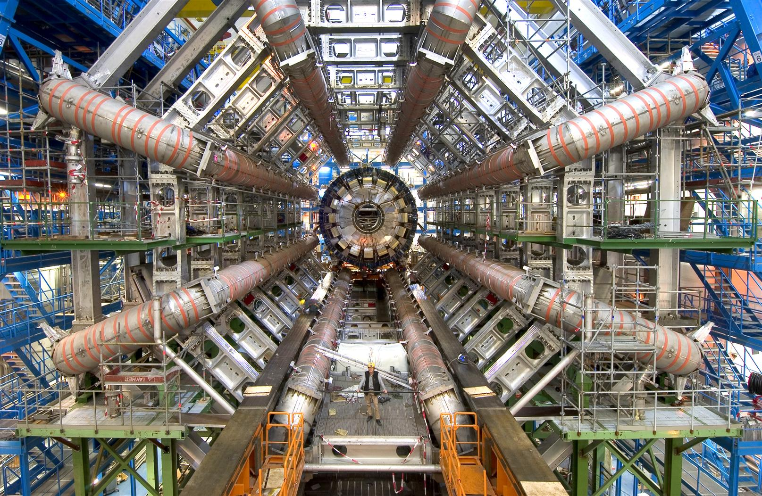
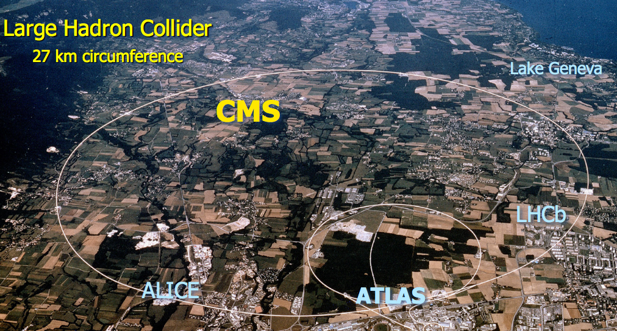
FTP Extensions
FTP with extensions are being used extensively in large data set transfers (e.g., LHC)

Slide 57
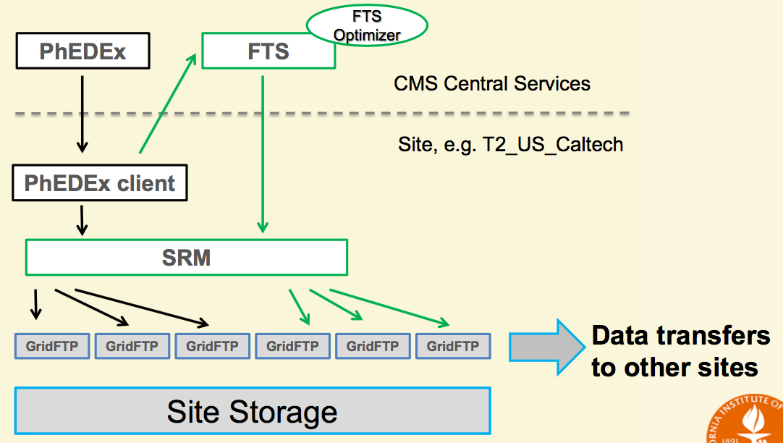
Data Transfer Structure
See GridFTP to FTP extensions
https://www.ogf.org/documents/GFD.20.pd
Goal of GridFTP: allow parallel, high-throughput data transfer
Discussion: What features do we need to add to FTP to allow parallel transfers?

Slide 58
FTP Evaluation
application
transport
network
data link
physical
request
Key questions to ask about a C-S application
- Is the application extensible?
- Is the application scalable?
- How does the application handle server failures (being robust)?
- How does the application provide security?
reply
application
transport
network
data link
physical
What are some interesting design features of the FTP protocol?

Slide 59
Backup Slides

Slide 60
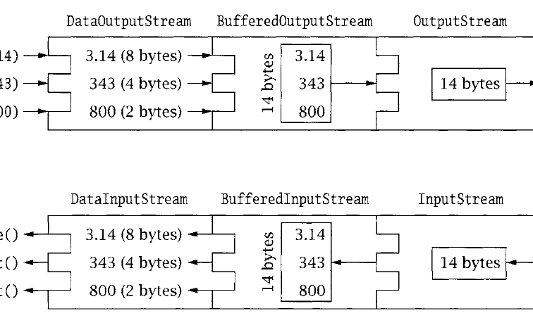
DataStream

